Slide 1
INDUSTRIAL TRAINING J2
TOPIC:- DIABETES PREDICTION
PRASANNA SAI KURITI RA1911026010068
SAI PRAVEEN SURA RA1911026010104

Slide 2
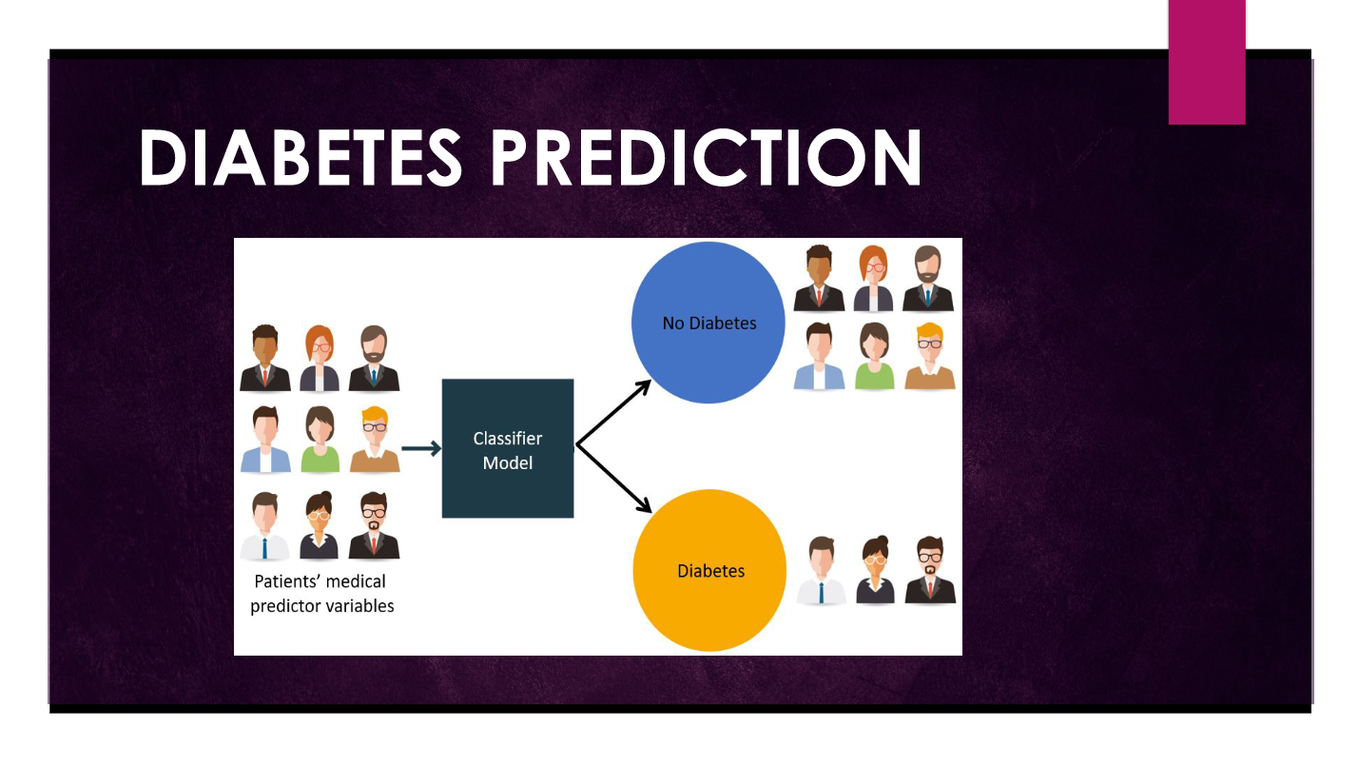

Slide 3
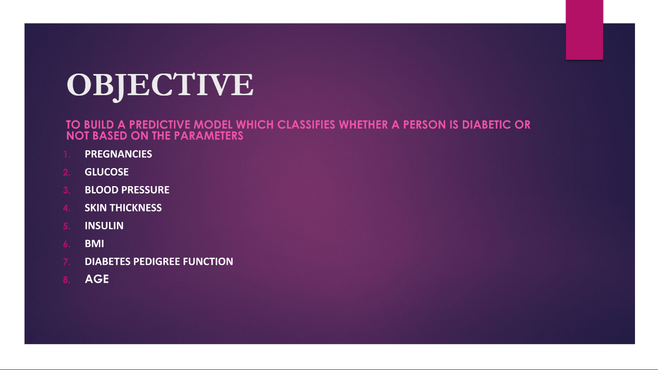

Slide 4
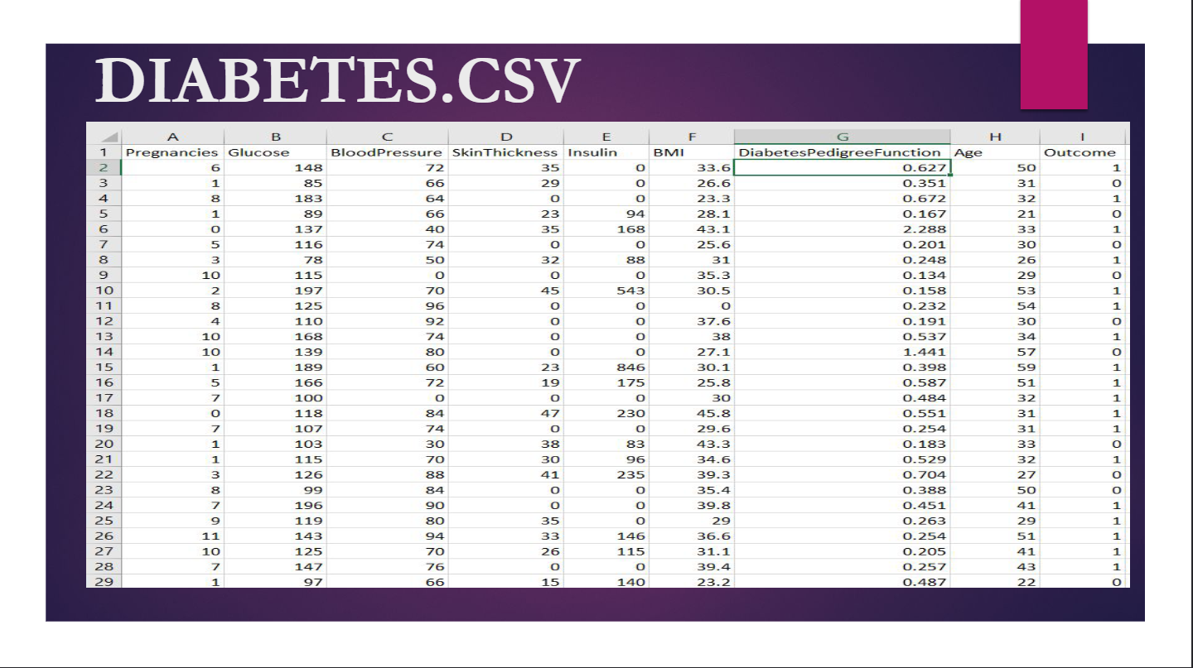

Slide 5
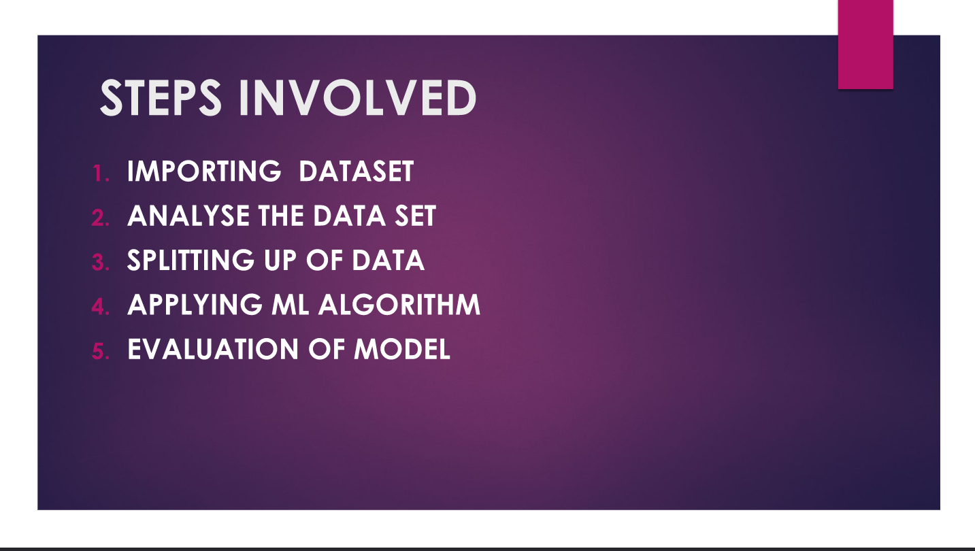

Slide 6
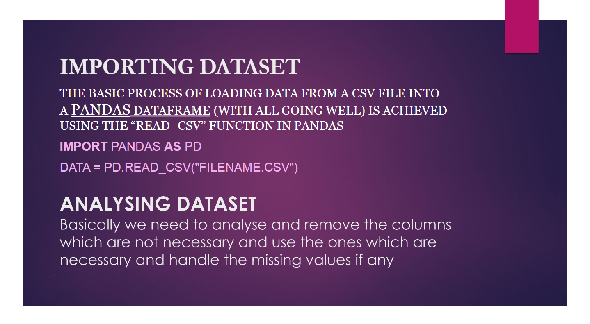

Slide 7
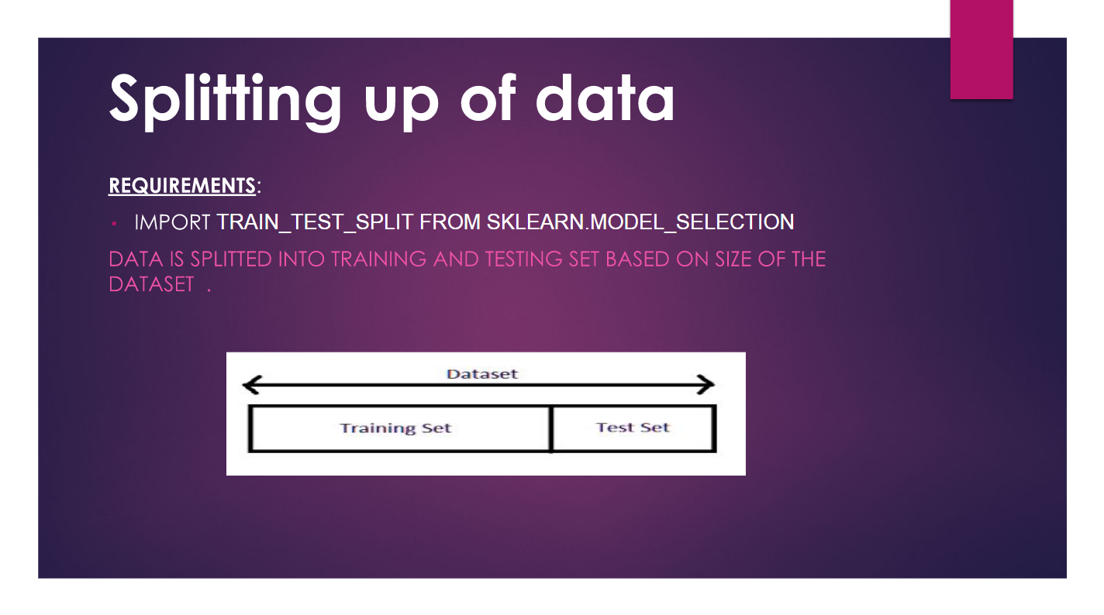

Slide 8
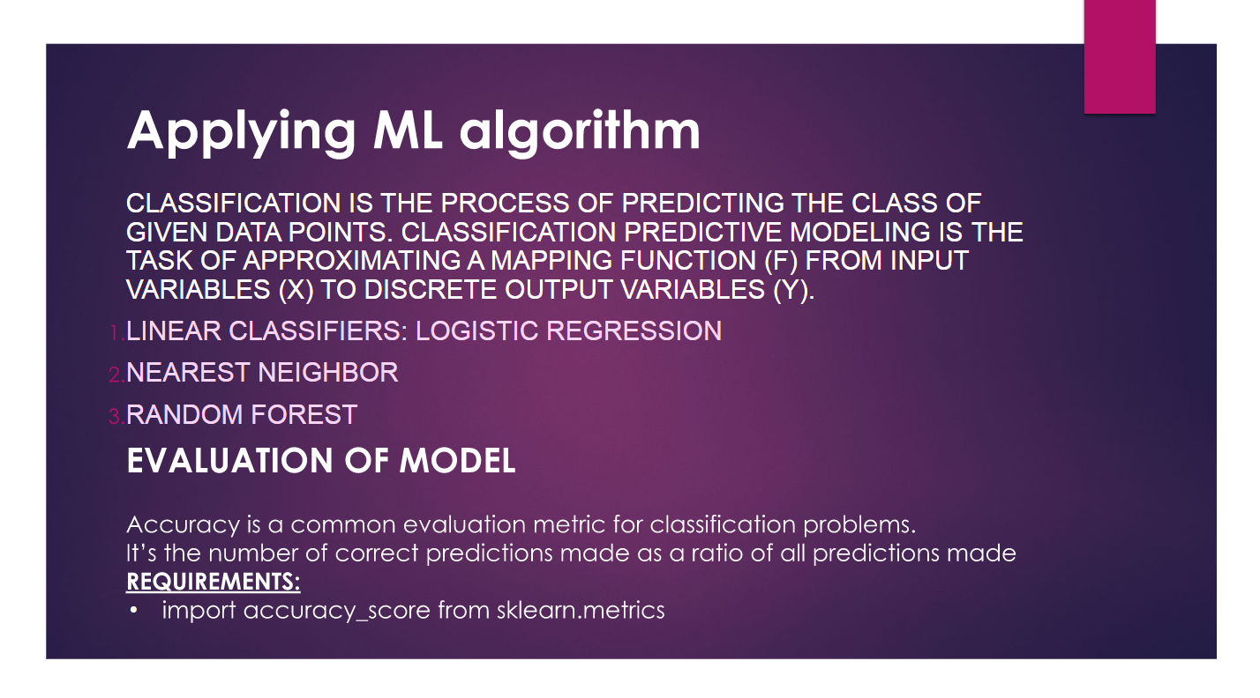

Slide 9
